Slide 1
Modern Database Systems
BITS Pilani
Prof. Ashish Narang
CSIS

Slide 2
BITS Pilani
<SSZG507, Modern Database Systems> Lecture No. 2

Slide 3
Contents
Introduction to SQL
SQL in Relational Database Systems
SQL Command Categories
Data Definition Language (DDL) Statements
Data Manipulation Language (DML) Statements
Data Retrieval using the SELECT Statement
SQL Joins and Subqueries
Transaction Basics and ACID Properties
Schema Evolution, Versioning, and Denormalisation
Limitations of Relational Databases and Motivation for NoSQL

Slide 4
Why SQL?
Relational databases store large volumes of structured data in tables. SQL provides a standard way to interact with this data efficiently and consistently.
SQL enables us to:
Create databases and tables.
Insert new records into tables.
Retrieve specific information from one or more tables.
Update existing records.
Delete unwanted records.
Manage transactions to maintain data integrity.
Control user access and permissions.

Slide 5
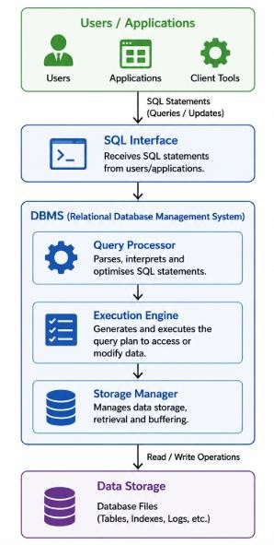
Where SQL Fits in the Database Architecture
SQL in a Relational Database System
SQL acts as the interface between users or applications and the relational database management system (RDBMS). Users issue SQL statements, which are processed by the DBMS to access or modify the data stored in the database.
Key Points
Applications communicate with the database using SQL.
The DBMS interprets and optimises SQL statements before execution.
Data is physically stored by the storage manager.
SQL provides a logical view of the data, hiding low-level storage details from users.

Slide 6
SQL Command Categories
SQL provides different categories of commands, each serving a specific purpose in defining, manipulating, retrieving, securing, and managing data within a relational database.
Category | Purpose | Common Commands
DDL (Data Definition Language) | Defines and modifies the database schema and objects | CREATE, ALTER, DROP, TRUNCATE, RENAME
DML (Data Manipulation Language) | Inserts, updates, and deletes data stored in tables | INSERT, UPDATE, DELETE, MERGE
DQL (Data Query Language) | Retrieves data from one or more tables | SELECT
TCL (Transaction Control Language) | Manages transactions to ensure reliable execution of database operations | COMMIT, ROLLBACK, SAVEPOINT
DCL (Data Control Language) | Controls user privileges and access to database objects | GRANT, REVOKE

Slide 7
Data Definition Language (DDL)
Data Definition Language (DDL) consists of SQL commands used to define, modify, and manage the structure of database objects. These commands affect the database schema rather than the data stored within the tables.
Command | Purpose
CREATE | Creates new database objects such as databases, tables, views, or indexes
ALTER | Modifies the structure of an existing database object
DROP | Permanently removes a database object
TRUNCATE | Removes all rows from a table while preserving its structure
RENAME | Changes the name of an existing database object (supported in many DBMSs)

Slide 8
CREATE TABLE Statement
The CREATE TABLE statement is used to define a new table by specifying its columns, data types, and constraints.
General Syntax
CREATE TABLE table_name ( column1 datatype [constraints],
column2 | datatype | [constraints],
...
columnN | datatype | [constraints]
);
Element | Description
Table Name | Student
Columns | StudentID, StudentName, Programme, Semester, CGPA
Data Types | Define the type of data each column can store (e.g., INT, VARCHAR, DECIMAL)
Constraints | Enforce rules such as uniqueness, mandatory values, and primary keys
Example
CREATE TABLE Student ( StudentID INT PRIMARY KEY,
StudentName VARCHAR(100) NOT NULL,
Programme VARCHAR(50),
Semester INT,
CGPA DECIMAL(3,2)
);

Slide 9
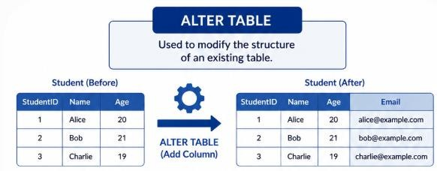
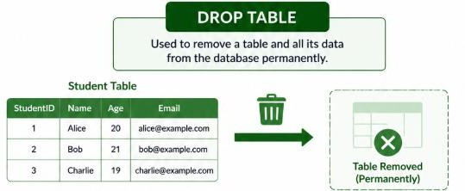
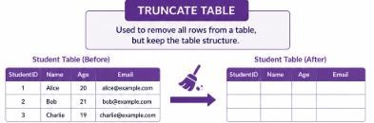
ALTER, DROP and TRUNCATE Statements
Once a table has been created, SQL provides commands to modify its structure or remove it when it is no longer required.
Alter Table Example
ALTER TABLE Student ADD Email VARCHAR(100);
DROP TABLE
DROP TABLE Student;
Truncate Table
TRUNCATE TABLE Student;

Slide 10
Data Manipulation Language (DML)
Data Manipulation Language (DML) consists of SQL commands used to insert, modify, delete, and merge data stored in database tables. Unlike DDL, which defines the database structure, DML operates on the records (rows) within those tables.
Command | Purpose
INSERT | Adds new rows to a table
UPDATE | Modifies existing rows
DELETE | Removes one or more rows from a table
MERGE | Inserts or updates rows based on matching conditions (supported in many DBMSs)

Slide 11
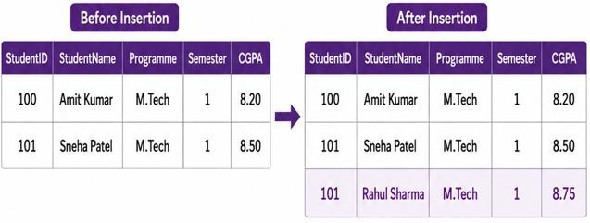
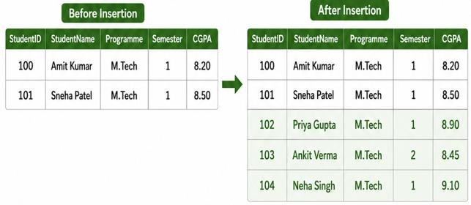
INSERT Statement
The INSERT statement is used to add one or more new rows to a table.
Example
INSERT INTO table_name (column1, column2, ..., columnN)
VALUES (value1, value2, ..., valueN);
Values must be provided in the same order as the specified columns, or the columns must be explicitly listed.
Example
INSERT INTO Student
(StudentID, StudentName, Programme, Semester, CGPA) VALUES (101, 'Rahul Sharma', 'M.Tech', 1, 8.75);
Inserting Multiple Values
INSERT INTO Student
(StudentID, StudentName, Programme, Semester, CGPA) VALUES
(102, 'Priya Gupta', 'M.Tech', 1, 8.90),
(103, 'Ankit Verma', 'M.Tech', 2, 8.45),
(104, 'Neha Singh', 'M.Tech', 1, 9.10);

Slide 12
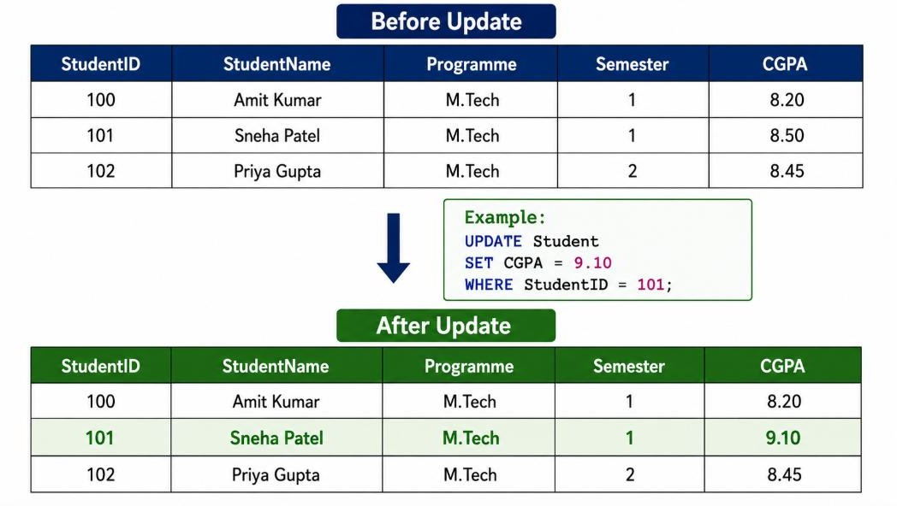
UPDATE Statement
The UPDATE statement modifies one or more existing rows in a table.
General Syntax
UPDATE table_name SET column1 = value1,
column2 = value2 WHERE condition;
Example
UPDATE Student
SET CGPA = 9.10
WHERE StudentID = 101;

Slide 13
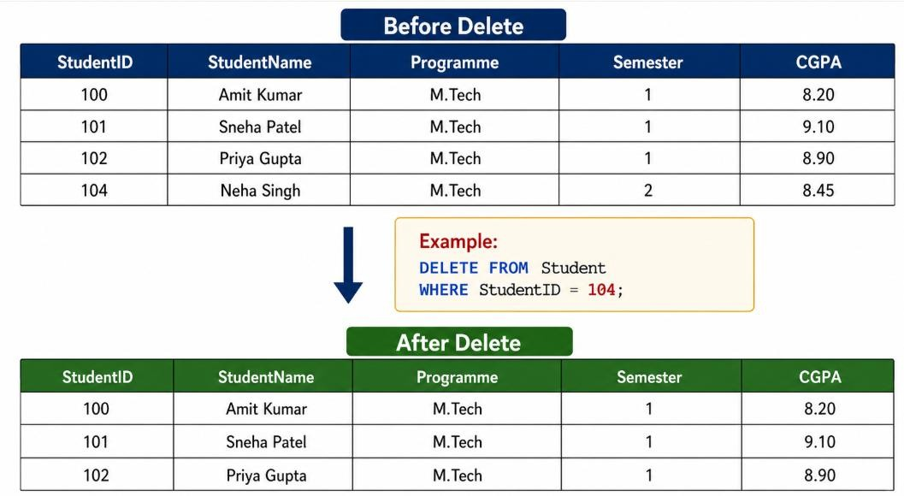
Delete Statement
The DELETE statement removes one or more rows from a table.
General Syntax
DELETE FROM table_name WHERE condition;
Example
DELETE FROM Student WHERE StudentID = 104;

Slide 14
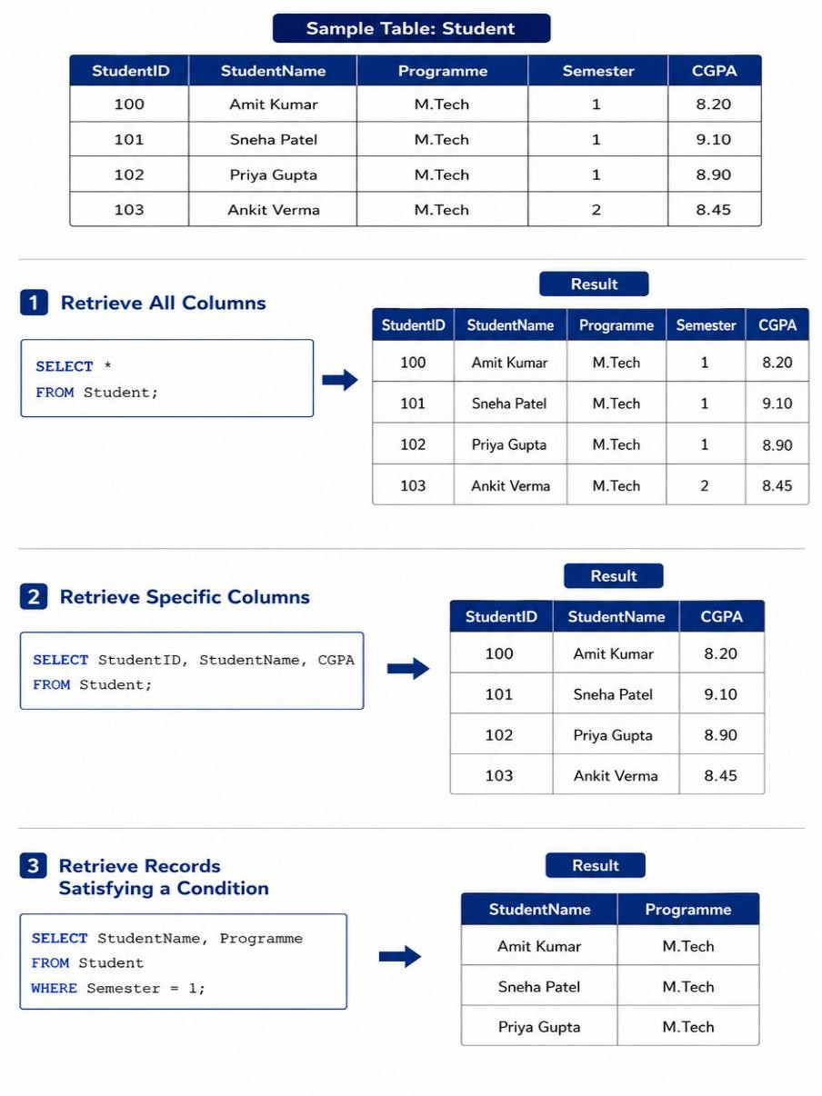
Retrieving Data using the SELECT Statement
SELECT Statement
The SELECT statement is used to retrieve data from one or more tables. It is the most
frequently used SQL statement for querying information stored in a relational database.
General Syntax
SELECT column1, column2, ... FROM table_name
WHERE condition;
Examples
1. Retrieve All Columns
SELECT *
FROM Student;
2. Retrieve Specific Columns
SELECT StudentID, StudentName, CGPA FROM Student;
3. Retrieve Records Satisfying a specific condition
SELECT StudentName, Programme FROM Student
WHERE Semester = 1;

Slide 15
Common Clauses Used with SELECT
The SELECT statement can be combined with various clauses to filter, sort, group, and
limit the data returned by a query.
Clause | Purpose | Example
FROM | Specifies the table(s) to retrieve data from | FROM Student
WHERE | Filters rows based on a condition | WHERE Semester = 1
DISTINCT | Eliminates duplicate values | SELECT DISTINCT Programme
ORDER BY | Sorts the result set | ORDER BY CGPA DESC
GROUP BY | Groups rows for aggregate calculations | GROUP BY Programme
HAVING | Filters groups after aggregation | HAVING AVG(CGPA) > 8.5
LIMIT / TOP | Restricts the number of rows returned | LIMIT 10

Slide 16
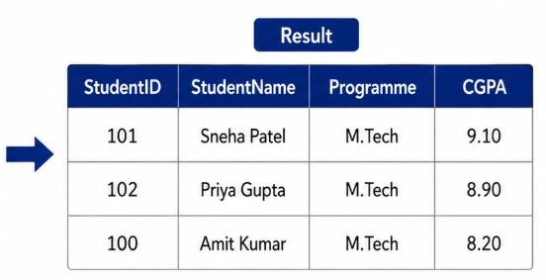
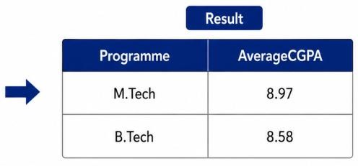
Examples
Example 1:
SELECT StudentID, StudentName, Programme, CGPA FROM Student
WHERE Semester = 1 AND CGPA > 8.0 ORDER BY CGPA DESC;
Example 2:
SELECT Programme, AVG(CGPA) AS AverageCGPA
FROM Student
GROUP BY Programme HAVING AVG(CGPA) > 8.5
ORDER BY AverageCGPA DESC;

Slide 17
Combining Data from Multiple Tables – Joins
SQL Joins
A JOIN combines rows from two or more tables based on a related column. Joins allow data stored in separate tables to be retrieved as a single result set.
Student
Course Enrollment
StudentID | StudentName | Programme
CourseID | CourseName | Credits
StudentID | CourseID | Semester
Question: Which courses is each student enrolled in?

Slide 18
Types of SQL Joins
SQL provides different types of joins depending on how matching and non-matching
rows from the participating tables should be returned.
Join Type | Description | Result
INNER JOIN | Returns only the rows that have matching values in both tables. | Matching rows only
LEFT OUTER JOIN | Returns all rows from the left table and the matching rows from the right table. | All left rows + matching right rows
RIGHT OUTER JOIN | Returns all rows from the right table and the matching rows from the left table. | All right rows + matching left rows
FULL OUTER JOIN | Returns all matching and non-matching rows from both tables. | All rows from both tables

Slide 19

INNER JOIN
An INNER JOIN returns only those rows where the join condition is satisfied in both tables.
Example
Student
Enrollment
StudentID | StudentName | Programme
101 | Rahul Sharma | M.Tech
102 | Priya Gupta | M.Tech
103 | Ankit Verma | MBA
StudentID | CourseID
101 | DB501
101 | AI502
102 | DB501
Result
SELECT S.StudentID, S.StudentName,
E.CourseID FROM Student S
INNER JOIN Enrollment E
ON S.StudentID = E.StudentID;
StudentID | StudentName | CourseID
101 | Rahul Sharma | DB501
101 | Rahul Sharma | AI502
102 | Priya Gupta | DB501

Slide 20
Comparison of SQL Join Types
The choice of join determines whether matching rows, non-matching rows, or both are included in the query result.
Student Enrollment
StudentID | StudentName | Programme
101 | Rahul Sharma | M.Tech
102 | Priya Gupta | M.Tech
103 | Ankit Verma | MBA
StudentID | CourseID
101 | DB501
101 | AI502
102 | DB501
Join Results
Join Type | Returned Rows
INNER JOIN | 101, 102 (matching rows only)
LEFT OUTER JOIN | 101, 102, 103 (all students + matching enrollments)
RIGHT OUTER JOIN | 101, 102, 104 (all enrollments + matching students)
FULL OUTER JOIN | 101, 102, 103, 104 (all rows from both tables)

Slide 21
Subqueries
A subquery (also called a nested query) is a query written inside another SQL query. The result of the inner query is used by the outer query to perform filtering, comparison, or data retrieval.
Syntax
SELECT column_name FROM table_name
WHERE column_name operator
(
SELECT column_name FROM table_name WHERE condition
);
Common Uses of Subqueries
Retrieve data based on the result of another query.
Compare values with aggregated results (e.g., average, maximum, minimum).
Filter records using IN, EXISTS, ANY, or ALL.
Simplify complex retrieval problems.

Slide 22
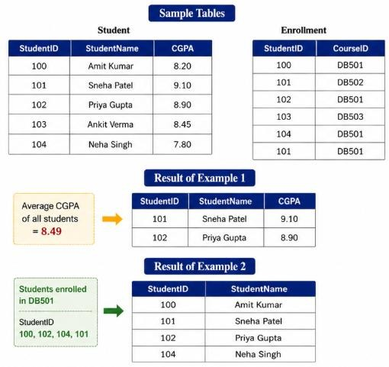
Examples of Subqueries
Example 1: Single-Row Subquery
Retrieve students whose CGPA is higher than the average
CGPA of all students.
SELECT StudentID, StudentName, CGPA FROM Student
WHERE CGPA > (
SELECT AVG(CGPA)
FROM Student
);
Example 2: Multi-Row Subquery
Retrieve students enrolled in the course DB501.
SELECT StudentID,StudentName FROM Student
WHERE StudentID IN (
SELECT StudentID FROM Enrollment
WHERE CourseID = 'DB501'
);

Slide 23
Transaction Basics in Relational Systems
A transaction is a sequence of one or more SQL operations that are executed as a single logical unit of work. A transaction is considered successful only if all its operations complete successfully; otherwise, all changes are undone.
Example: Bank Fund Transfer
Transferring ₹5,000 from Account A to Account B involves two operations:
UPDATE Account
SET Balance = Balance - 5000 WHERE AccountID = 'A';
UPDATE Account
SET Balance = Balance + 5000
WHERE AccountID = 'B';
Key Characteristics
A transaction may contain one or more SQL statements.
The database treats the entire transaction as one unit of work.
Either all operations succeed, or none of them take effect.

Slide 24
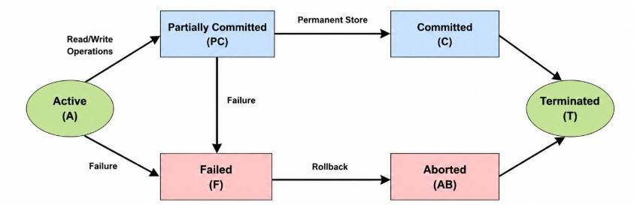
States of a Transaction
During its execution, a transaction passes through a sequence of states before it either completes successfully or is terminated due to an error.
State | Description
Active | The transaction is currently executing one or more SQL statements.
Partially Committed | The final SQL statement has executed, but the changes have not yet been permanently recorded.
Committed | The transaction has completed successfully and all changes are permanently saved.
Failed | An error, system failure, or constraint violation prevents successful completion.
Aborted | All changes made by the transaction are rolled back, restoring the database to its previous consistent state.
Source: https://medium.com/@matheesha27/transaction-states-acid-properties-in-a-dbms-94197273a14a

Slide 25
ACID Properties of Transactions
To ensure reliable and consistent transaction processing, relational database systems guarantee the ACID properties.
Property | Description | Example
Atomicity | A transaction is executed completely or not at all. | During a fund transfer, both the debit and credit operations succeed together; otherwise, both are rolled back.
Consistency | A transaction moves the database from one valid state to another while preserving integrity constraints. | The total amount of money in the banking system remains unchanged after a transfer.
Isolation | Concurrent transactions execute without interfering with each other. | Two users updating the same account should not produce incorrect balances.
Durability | Once a transaction is committed, its changes remain permanent even after a system failure. | A completed online payment is not lost after a server restart.

Slide 26
Schema Evolution
Schema evolution refers to the process of modifying the structure of a database while preserving existing data and maintaining application compatibility.
Examples of Schema Changes
Change | SQL Operation
Add a new column | ALTER TABLE ... ADD COLUMN
Modify a column | ALTER TABLE ... MODIFY COLUMN
Remove a column | ALTER TABLE ... DROP COLUMN
Rename a table or column | ALTER TABLE ... RENAME
Why is Schema Evolution Required?
New business requirements introduce additional data attributes.
Existing attributes may need to be modified or removed.
Relationships between entities may change over time.
Performance and scalability requirements may require schema redesign.

Slide 27
Schema Versioning
Schema versioning is the practice of maintaining and tracking different versions of a database schema as it evolves. It enables databases and applications to evolve in a controlled manner while preserving compatibility and supporting reliable deployments.
Why is Schema Versioning Important?
Tracks changes made to the database schema over time.
Ensures all environments (development, testing, and production) use the correct schema version.
Supports controlled deployment of database updates.
Enables rollback if a schema change introduces issues.
Facilitates collaboration among multiple developers.

Slide 28
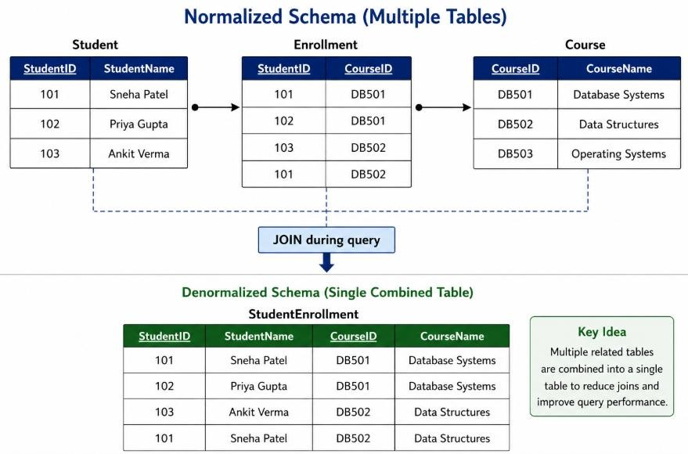
Denormalisation
Denormalisation is the process of intentionally introducing redundancy into a database schema to improve query performance and reduce the need for complex joins.
Why Denormalise?
Reduce the number of table joins during
query execution.
Improve read performance for frequently executed queries.
Simplify reporting and analytical queries.
Optimize performance for large-scale applications.

Slide 29
Limitations of Relational Database Systems
Relational databases provide strong consistency, structured data management, and powerful SQL capabilities. However, modern applications often introduce requirements that are difficult to satisfy using traditional relational database systems alone.
Limitation | Example
Rigid Schema | Frequently changing data structures require schema modifications.
Horizontal Scalability | Scaling to millions of users often requires complex sharding strategies.
Semi-Structured Data | JSON, XML, logs, and multimedia data do not naturally fit relational tables.
High Write Throughput | IoT sensors, clickstreams, and social media generate massive volumes of writes.
Distributed Data Management | Maintaining ACID properties across geographically distributed systems can increase latency and complexity.

Slide 30
Thank You

